Slide 1

Lecture 4: Input/Output and Program Management
Dr. Amir Yavariabdi
amir.yavariabdi@bth.se
1

Slide 2
Outline:
Transporting Bytes on Streams in Unix.
Understanding Buffers and their significance in I/O operations
File handling in Unix (open, read, write, close)
Working with Directories in Unix
Object code, linking, and compiling C programs in Unix environments
Introduction to Makefiles and their role in building complex projects

Slide 3
Introduction to I/O in C Programming
Input/Output (I/O) in Programming: In C programming, input/output operations are crucial for making programs interactive and functional, allowing them to receive input from users, files, or devices, and to output results accordingly.
Types of I/O:
User I/O: This type involves interactions between the program and the user, typically through a keyboard for input and a display screen for output.
File I/O: In file I/O, the program interacts with the file system to read from or write data to files stored on disk.
Device I/O: Device I/O involves communication between the program and hardware devices.

Slide 4
Understanding Streams
What are Streams?
Definition: Streams are a way to represent the flow of data between your C program and various input/output (I/O) sources or destinations.
Purpose: They simplify how data is transferred by treating it as a continuous sequence of bytes.
Examples of I/O Sources
Keyboard: When you type input in the terminal, it is read as a stream of bytes.
Files: Data can be read from or written to files on your disk, treated as streams of bytes.
Sensors: External devices that provide data to your program, such as temperature sensors, also use streams.
Examples of I/O Destinations
Display Screens: Output data from your program can be shown on your terminal or monitor.
Files: Data can be saved to files on your computer.
Printers: Information can be sent to a printer for physical output.
Other Programs: Data can be passed between programs, enabling communication or data sharing

Slide 5
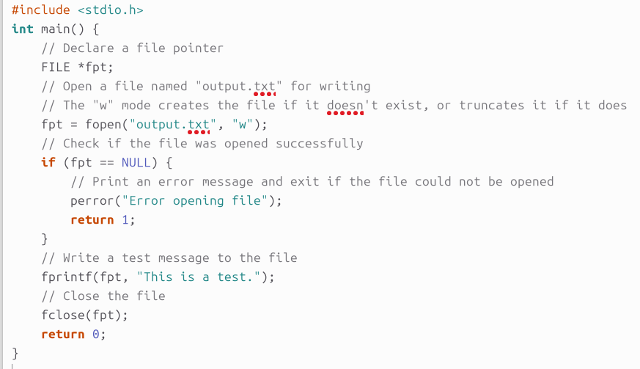
Understanding Streams
Stream Model in Operating Systems
Consistency: Modern operating systems like Unix use the stream model to manage I/O operations. This provides a unified approach to handle various types of data flows.
Functionality: When your program performs I/O operations, it interacts with streams managed by the operating system, ensuring that data flows smoothly between sources and destinations.
Example1: creating, using, and closing a stream
Notes:
When fopen() is called, a stream connection is established between the program and the file.
When fprintf() is called, bytes are passed along the stream from the program to the file. When fclose() is called, the stream connection is broken

Slide 6
Example 1: Understanding Streams
This pointer will be used to manage the file.
Opens the file output.txt in write mode. If output.txt does not exist, it will be created. If it exists, its content will be truncated.
Writes the string "This is a test." to the file.
Closes the file to ensure all data is written and resources are freed.

Slide 7
Establishing I/O Connections in C
Using fopen() to Open Streams: The fopen() function in C is used to establish a connection between a program and a file, creating a stream that allows data to be read from or written to the file.
Some of the possible mode keyword parameters:
r: Open a text file for reading. The file must exist.
w: Create a text file for writing. If the given file exists, its contents are destroyed.
a: Open a text file in append mode for writing at the end of the file.
#include <stdio.h> FILE *fopen(const char *filename, const char *mode);

Slide 8
Establishing I/O Connections in C
Using fopen() to Open Streams: The fopen() function in C is used to establish a connection between a program and a file, creating a stream that allows data to be read from or written to the file.
Some of the possible mode keyword parameters:
r: Open a text file for reading. The file must exist.
w: Create a text file for writing. If the given file exists, its contents are destroyed.
a: Open a text file in append mode for writing at the end of the file.
#include <stdio.h> FILE *fopen(const char *filename, const char *mode);
FILE *fpt; fpt = fopen("output.txt", "w");

Slide 9
Establishing I/O Connections in C
fprintf() Function: Writes formatted data to the file via the established stream, sending a text to the txt file.
fclose() Function: Closes the stream and releases any resources associated with the file, ensuring that all data is properly saved.
#include <stdio.h> int fprintf(FILE *stream, const char *format-string, argument-list);
FILE *fpt; fpt = fopen("output.txt", "w"); fprintf(fpt, "This is a test.");
FILE *fpt; fpt = fopen("output.txt", "w"); fprintf(fpt, "This is a test."); fclose(fpt);
#include <stdio.h> int fclose(FILE *stream);

Slide 10
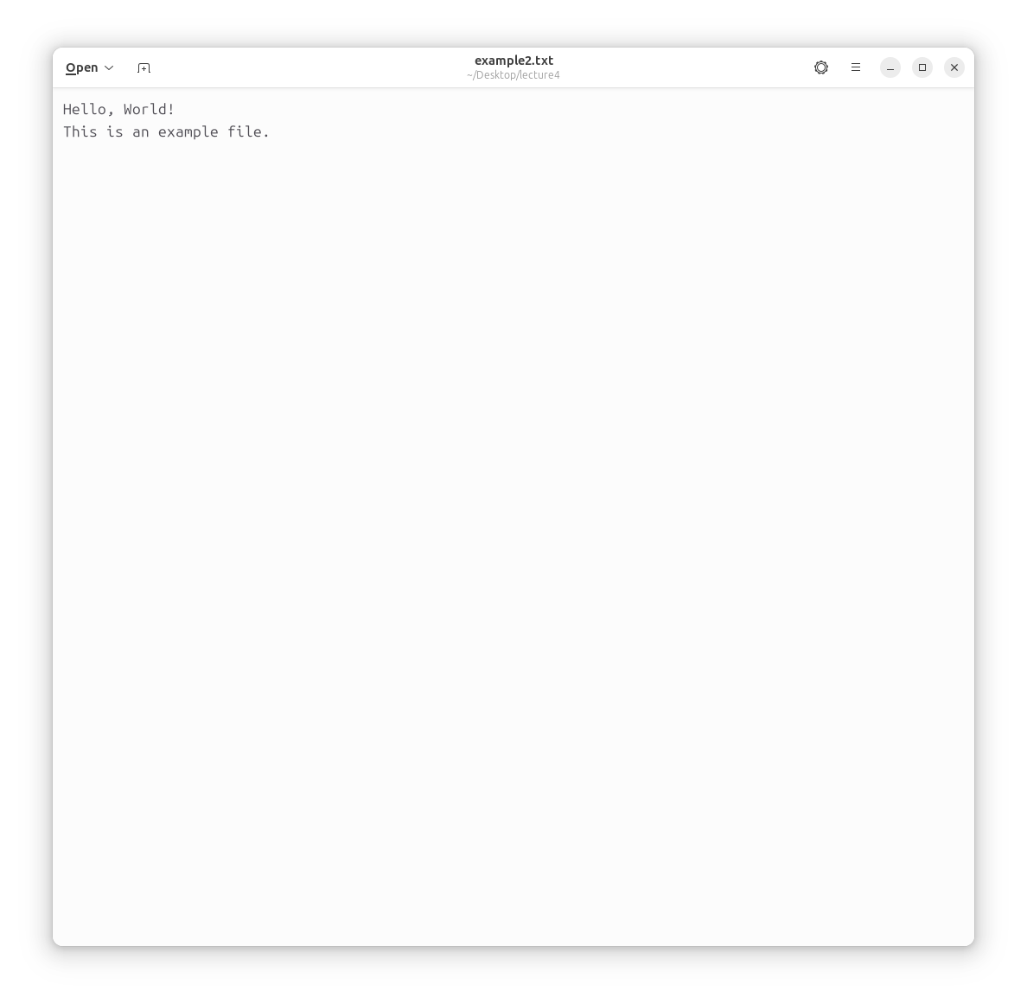
Example 2: I/O Connections
Write a C program to perform the following operations on a text file:
Read the content of a text file named example2.txt.
Update the content by appending a new line of text to the existing content.
Rewrite the updated content back to the same text file (example2.txt).
Close the file after the operations are completed.
Example2 text file

Slide 11
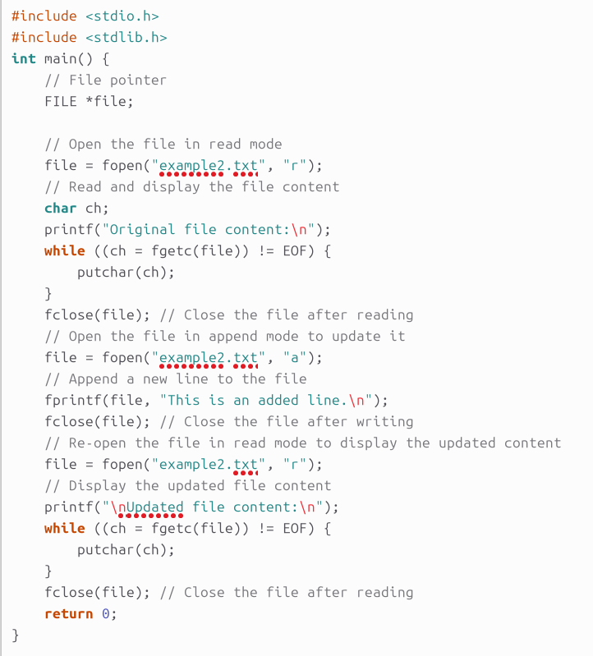
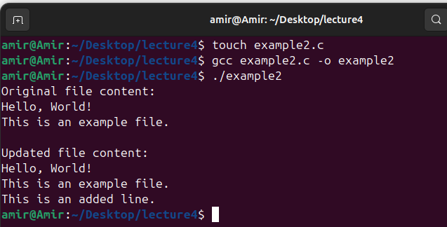
Example 2: I/O Connections

Slide 12
Example 2: Explanation
File Opening (fopen):
The program begins by opening the file example.txt in read mode ("r"). This allows the program to read the existing content of the file.
Reading the File Content (fgetc):
The file's content is read character by character using fgetc(file) in a while loop until the end of the file (EOF) is reached.
The putchar(ch) function is used to print each character to the console.

Slide 13
Example 2: Explanation
Appending New Content (fopen in append mode and fprintf):
After reading, the file is reopened in append mode ("a"). This allows the program to add new content to the end of the file without deleting the existing content.
The fprintf(file, "This is an added line.\n"); is used to add a new line of text to the file.
Re-reading the Updated Content and Closing the File (fclose):
To verify that the new content was successfully added, the file is reopened in read mode.
After each operation (reading or writing), the file is closed using fclose(file). This ensures that all changes are saved, and resources are freed.

Slide 14
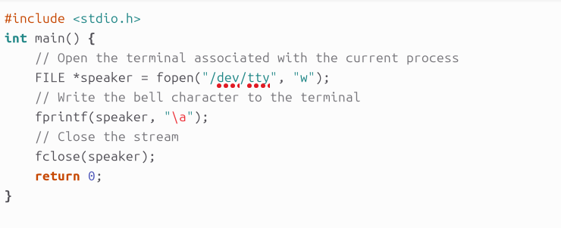
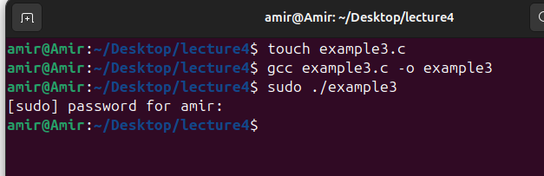
Example 3: I/O Connections
Write a C program that produces a beep sound on the terminal.
The program should open a special file associated with the terminal device and use it to output the bell (alert) character (“\a”: ASCII bell character).
Ensure that the program properly handles the file stream by opening it before use and closing it afterward.
opens the terminal device file /dev/tty. This file shows the terminal associated with the current process. Opening it in write mode allows the program to send output directly to the terminal.
Run the executable with sudo to grant the necessary permissions

Slide 15
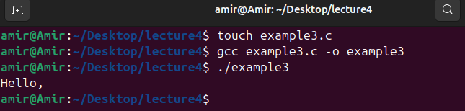
Transporting Bytes Using fscanf() and fprintf()
fscanf() and fprintf() functions are specialized for handling formatted text data, allowing the program to read from or write to streams with specific formatting rules.
fscanf() Function: Reads formatted data from a stream and stores it in variables according to format specifiers, such as %s for strings or %d for integers.
fprintf() Function: Writes formatted data to a stream, converting variables to text according to the format specifiers before sending them to the output destination.
FILE *fpt; char text[80]; fpt = fopen("example2.txt", "r"); fscanf(fpt, "%s", text); printf("%s\n", text); fclose(fpt);

Slide 16
Transporting Bytes Using fscanf() and fprintf()
fscanf() and fprintf() functions are specialized for handling formatted text data, allowing the program to read from or write to streams with specific formatting rules.
fscanf() Function: Reads formatted data from a stream and stores it in variables according to format specifiers, such as %s for strings or %d for integers.
fscanf reads one formatted input at a time (e.g., one word, one number).
To read everything in the file, we need to call fscanf multiple times, which is why we use it with a loop.
The loop continues until fscanf reaches the end of the file (EOF).
fprintf() Function: Writes formatted data to a stream, converting variables to text according to the format specifiers before sending them to the output destination.

Slide 17
Example 4: fscanf() and fprintf()
Write a C program to perform the following operations on a text file:
Read the content of a text file named example2.txt using fscanf.
Update the content by appending a new line of text to the existing content.
Rewrite the updated content back to the same text file (example2.txt) and read the file again using fscanf.
Close the file after the operations are completed.
Example2 text file

Slide 18
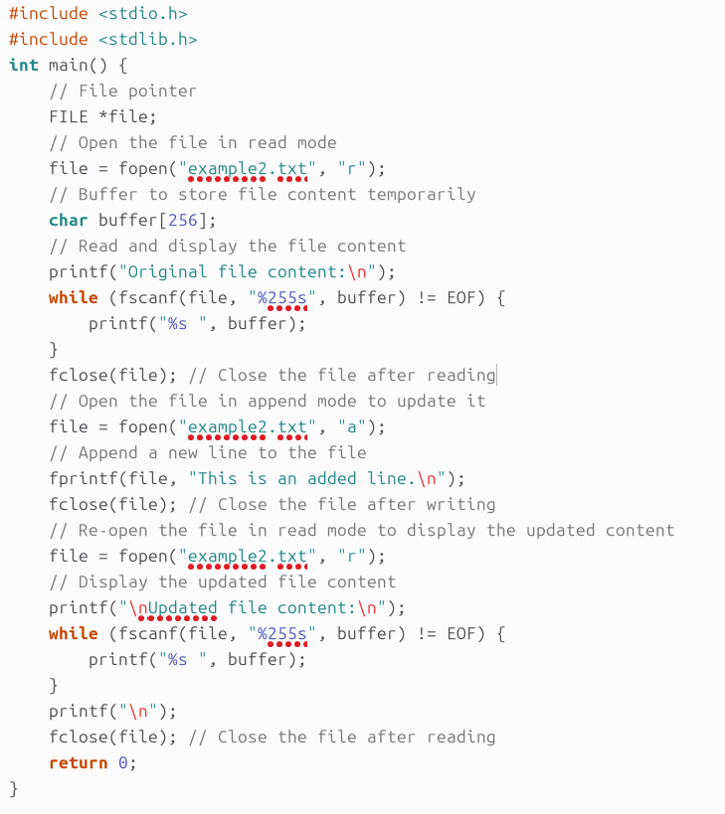
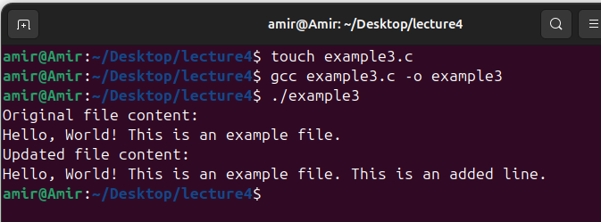
Example 4: fscanf() and fprintf()

Slide 19
Example 4: Explanation
fscanf(file, "%255s", buffer):
Reads a string (up to 255 characters) from the file and stores it in buffer. The %255s format specifier tells fscanf to read a string, but only up to 255 characters to avoid buffer overflow.
It reads input word by word. Each word is defined as a sequence of characters delimited by whitespace (space, newline, etc.).
Printing Words:
After reading each word, it is immediately printed with a space for separation.
The final output may differ slightly because fscanf will ignore whitespace and treat consecutive words as separate inputs.

Slide 20
Example 4: Explanation
Usage Scenario
fgetc: Use fgetc when you want to read a file character by character, including all spaces, newlines, and other whitespace.
fscanf: Use fscanf when you want to read formatted data like integers, floats, or strings (words). It's good for reading files where data is structured and separated by whitespace.
Notes
Using fscanf for file content reading in this way will treat each word separately, and it will change the original formatting, such as multiple spaces and newlines, which fgetc would preserve.
Choose the method (fgetc or fscanf) based on the specific needs of an application.

Slide 21
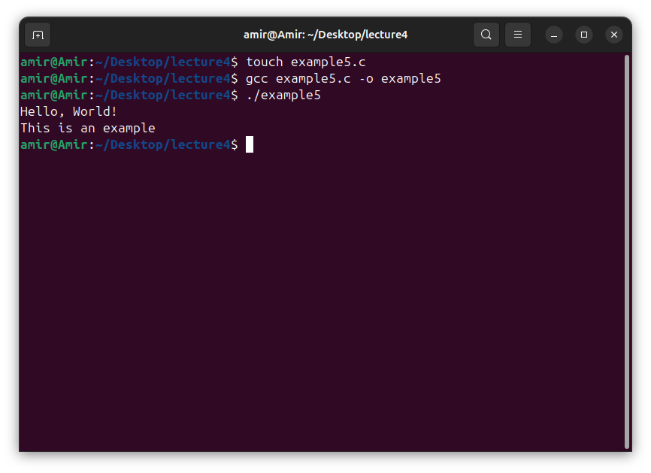
Generic Byte Transfer with fread() and fwrite()
fread() and fwrite() Functions for Raw Data Transfer: Unlike fscanf() and fprintf(), these functions transfer raw bytes without interpreting or formatting them, making them suitable for handling binary data or custom data formats.
fread() Function: Reads a specified number of bytes from a stream and stores them in a memory location within the program.
fwrite() Function: Writes a specified number of bytes from a memory location in the program to a stream.
FILE *fpt; char text[80]; fpt = fopen("example2.txt", "r"); fread(text, 1, 33, fpt); text[33] = '\0'; printf("%s\n", text); fclose(fpt);
Declares an 80-byte character array text to store file data.

Slide 22
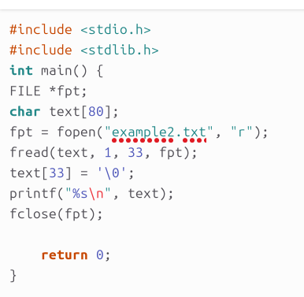
Example5: Generic Byte Transfer with fread() and fwrite()
Declares an 80-byte character array text to store file data.
Reads up to 33 bytes from the file and stores them in the text array. The parameters are:
text: Pointer to the buffer where data will be read.
1: Size of each element (1 byte in this case).
33: Number of elements to read.
Adds a null terminator at position 33 to ensure the string is properly terminated. This is important for correct string handling and printing. This approach assumes that the file has at least 33 bytes; otherwise, it may lead to undefined behaviour (since there could be no null terminator within the valid file content).

Slide 23
Error Handling in I/O Operations
Importance of Error Checking in I/O: Error handling is crucial in I/O operations to ensure that data is correctly read from or written to streams, and to handle cases where operations fail (e.g., end of file, file not found).
Error Handling Functions:
ferror(FILE *stream) checks for errors during file operations.
feof(FILE *stream) detects if the end of the file has been reached.
Checking Return Values: Functions like fread() return the number of bytes actually read, which can be compared to the expected number to detect errors or the end of a file.
if (ferror(fpt)) { printf("Error reading file.\n"); } if (feof(fpt)) { printf("End of file reached.\n"); }
int bytes_read; bytes_read = fread(text, 1, 70, fpt); if (bytes_read < 70) { printf("Reached end of file.\n"); }

Slide 24
System I/O Functions in C
System-level I/O function allow to interact more directly with the operating system.
C provides lower-level system I/O functions, such as:
open(): This function is used to open a file or device. We specify the file's path, access mode (read-only or write-only), and, if creating a new file, its permissions. It returns an integer that we use to reference the open file. If the operation fails, it returns -1.
close(): This function is used to close a file descriptor that was previously opened with open(). You pass the file descriptor to this function, and it returns 0 on success. If it fails, it returns -1.
read(): This function reads data from a file descriptor into a buffer. You provide the file descriptor, a pointer to the buffer where the data should be stored, and the number of bytes to read. It returns the number of bytes actually read, 0 if the end of the file is reached, or -1 if an error occurs.
write(): This function writes data from a buffer to a file descriptor. You provide the file descriptor, a pointer to the buffer containing the data, and the number of bytes to write. It returns the number of bytes written or -1 if an error occurs.

Slide 25
Example 6: System I/O Functions
Write a C program that performs the following operations on a file named example6.txt:
Opens the file for writing, creating it if it does not exist, and truncating it to zero length if it does.
Writes the string "Hello" to the file.
Closes the file.
Reopens the file for reading.
Reads the content of the file into a buffer and prints it.
Closes the file again.

Slide 26
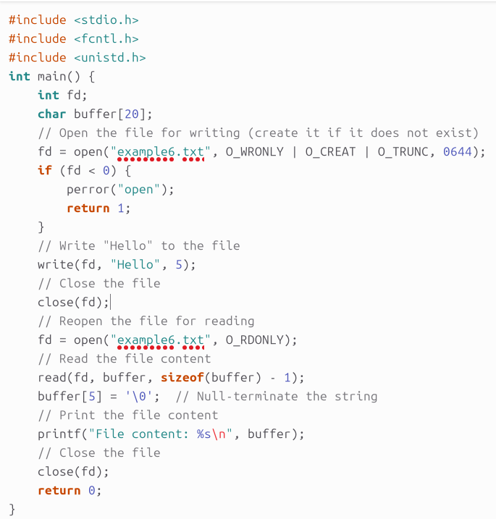

Example 6: System I/O Functions

Slide 27
Example 6: Explanation
Headers:
#include <fcntl.h>: Defines constants and function prototypes related to file control, such as file opening flags.
Provides the O_WRONLY, O_CREAT, O_TRUNC, and O_RDONLY constants used in the open() function to specify file access modes and attributes.
#include <unistd.h>: Contains declarations for POSIX operating system API functions, including file I/O functions such as open(), read(), write(), and close() functions.
Open the file for writing:
The open() function with flags O_WRONLY | O_CREAT | O_TRUNC opens the file in write-only mode, creates it if it doesn't exist, and truncates it to zero length if it does.
The 0644 sets the file permissions so that the file owner can read and write to the file, while the group and others can only read it. The 0 is used to indicate that the number is in octal.
0 = No permissions (---) 1 = Execute only (--x) 2 = Write only (-w-) | 3 = Write and execute (-wx) 4 = Read only (r--) 5 = Read and execute (r-x) | 6 = Read and write (rw-) 7 = Read, write, and execute (rwx)

Slide 28
Example 6: Explanation
Write to the file:
The write() function writes the string "Hello" (5 bytes) to the file.
Close the file:
The close() function closes the file descriptor after writing.
Reopen the file for reading:
The open() function with flag O_RDONLY reopens the file in read-only mode.
Read the file content:
The read() function reads up to sizeof(buffer) - 1 bytes from the file into the buffer.
The buffer[5] = '\0'; line null-terminates the string to ensure it's properly terminated for printing.
Close the file:
The close() function closes the file descriptor after reading.

Slide 29
High-Level I/O Functions vs. Low-Level System I/O Functions
High level I/O functions, such as fopen(), fprintf(), and fscanf(), provide a user-friendly interface that abstracts away complex details.
Low-level I/O functions, such as open(), read(), and write(), offer a higher level of control over file descriptors and I/O operations and they are less user-friendly.
High level I/O functions make programming simpler by managing tasks like data formatting and buffering (manage the flow of data between two locations or device) automatically.
Low-level I/O functions are designed for scenarios where direct manipulation of I/O resources is necessary and they do not automatically handle buffering.
Programmers must manage buffering themselves if needed, which allows for customized performance optimization and precise control over data handling.

Slide 30
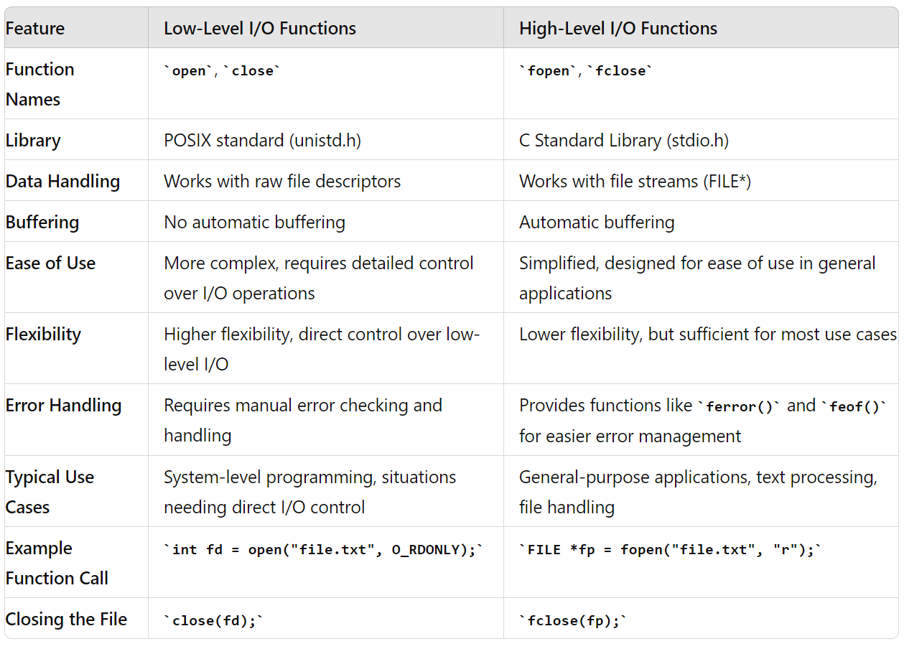
High-Level I/O Functions vs. Low-Level System I/O Functions
High level I/O functions are suitable for general applications as they manage many details automatically.
Low-level I/O functions are suited for system-level programming where fine-tuned control over I/O operations and performance is crucial.

Slide 31
Buffering
Buffering involves temporarily storing data in a memory area (buffer) before it is read from or written to a file or device.
Buffering enhances performance by reducing the number of I/O operations and managing data more efficiently.
Types of Buffers:
Input Buffers: Store data read from files or devices before it is processed.
Line-buffered: Output is sent to the terminal when a newline character (\n) is encountered. This is common when writing to the terminal.
Fully buffered: Output is sent when the buffer is full. This is common when writing to files.
Unbuffered: Output is sent immediately. This is less common.
Output Buffers: Hold data to be written to files or devices until the buffer is full or explicitly flushed (writes the information stored in the buffer to storage (hdd, ssd, etc).

Slide 32
Buffering: fflush() Function
fflush function forces the output buffer to be written to the file or terminal immediately.
int fflush(FILE *stream);
Pointer to a FILE object. If NULL, flushes all output streams.
Usage:
Immediate Output: Ensures data is visible or saved immediately.
In C, standard output (stdout), which is where printf writes to, is typically buffered.
This means that instead of sending every single character to the terminal immediately, the system collects (buffers) the output and then sends it all at once under certain conditions.

Slide 33
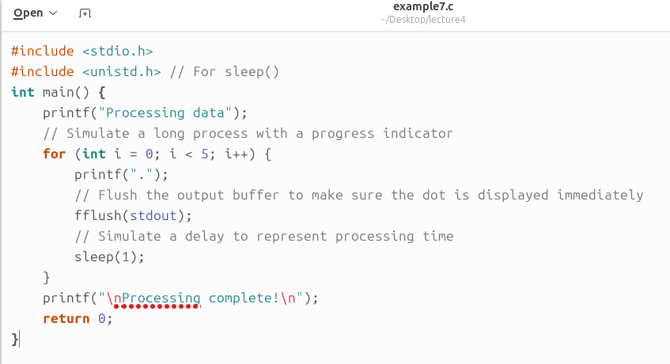
Example 7: fflush() Function
Imagine we are writing a program that processes data and you want to display a progress indicator (like dots appearing on the screen) to show that the program is working. Without fflush(), the progress indicator might not show up as expected, making the program seem unresponsive.
Without fflush(stdout);: The program might wait until the loop finishes before displaying all the dots at once. This would make the progress indicator useless, as the user wouldn't see the dots appearing one by one.
With fflush(stdout);: Each dot is displayed immediately after printf(".");, giving the user real-time feedback that the program is still processing.

Slide 34
Buffering: fflush() Function
A pipe in C is a method used to enable inter-process communication (IPC) or pass the output of one command as input to another.
It allows data to flow from one process to another in a unidirectional way.
Unidirectional Data Flow: Pipes only allow data to flow in one direction.
For example, if you create a pipe between two processes, one process can write data to the pipe, and the other process can read it.
File Descriptor: When a pipe is created using the pipe() system call, it generates two file descriptors:
fd[0]: Used for reading from the pipe.
fd[1]: Used for writing to the pipe.
Parent and Child Processes: Pipes are commonly used between parent and child processes after a fork() system call.
The parent process can send data to the child process or vice versa.

Slide 35
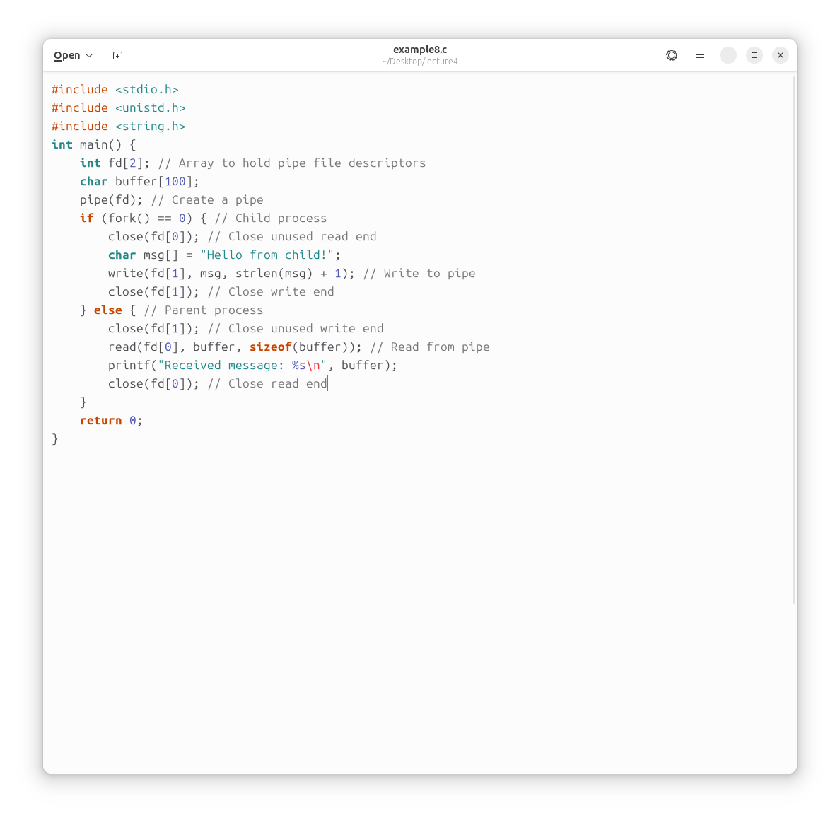
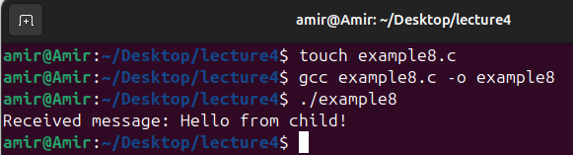
Example 8: Communication Between Parent and Child Process Using a Pipe
In Unix-like operating systems, a pipe is a method for inter-process communication (IPC). It allows data to be passed from one process to another. This example demonstrates how a parent process can communicate with its child process using a pipe.

Slide 36
Example 8: Explanation
Pipe Creation:
The pipe(fd) function creates a pipe. fd is an array where fd[0] is the read end, and fd[1] is the write end of the pipe. Data written to fd[1] can be read from fd[0].
Forking the Process:
The fork() function creates a new process. The child process receives a return value of 0 from fork(), and the parent process receives the process ID of the child. Here, the code inside if (fork() == 0) is executed only by the child process.

Slide 37
Example 8: Explanation
Child Process:
The child process closes the read end of the pipe (fd[0]) because it only needs to write data to the pipe.
It then writes a message ("Hello from child!") to the write end of the pipe (fd[1]).
After writing, the child closes the write end of the pipe.
Parent Process:
The parent process closes the write end of the pipe (fd[1]) because it only needs to read data from the pipe.
It reads the message sent by the child from the read end of the pipe (fd[0]) into the buffer.
The message is then printed to the terminal, showing "Received message: Hello from child!".
Finally, the parent process closes the read end of the pipe.

Slide 38
Program Management from Code to Program
Program management is about how programs are organized, built, and distributed.
It ensures that programs are easy to understand, modify, and run on different systems.
From Code to Program: Building Blocks
Source Code: The code you write (e.g., main.c).
Building: Turning this code into something the computer can run.
Steps:
Compiling: Translating your code into a form the computer can understand.
Linking: Putting together all the pieces of the program.

Slide 39
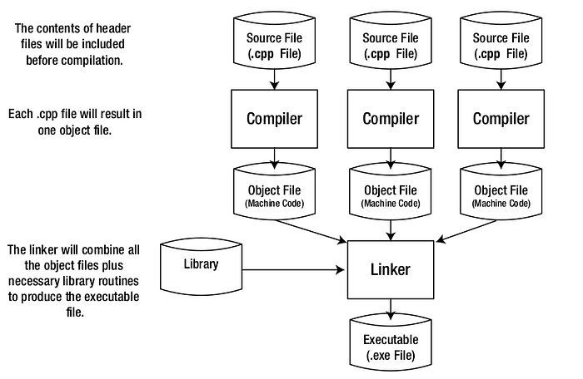
Program Management from Code to Program
The basic steps in building a program.

Slide 40
Object Files
Object files are intermediate files generated from source code.
An object code file contains machine code which is instructions that can be run on the processor.
Object code file cannot be directly executed and must be linked to become an executable program that can be run.
The -c flag tells gcc to stop after the compile stage and not to proceed to linking.
This creates a file named example9.o that contains object code.
#include <stdio.h> int main() { printf("Hello, World!\n"); return 0; } | amir@Amir:~/Desktop/lecture4$ touch example9.c amir@Amir:~/Desktop/lecture4$ gcc -c example9.c amir@Amir:~/Desktop/lecture4$ ls | Terminal ls output: example9.c example9.o

Slide 41
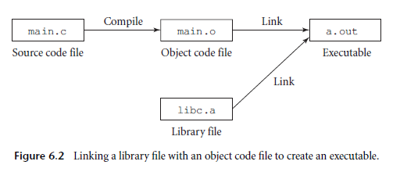
The Role of Linking
Linking combines object files and libraries into a single executable program.
Linking ensures all parts of the program work together and includes necessary library functions.
Example:
Object Files: main.o, utils.o
Linking Command: gcc main.o utils.o -o myprogram
Result: myprogram (an executable file)

Slide 42

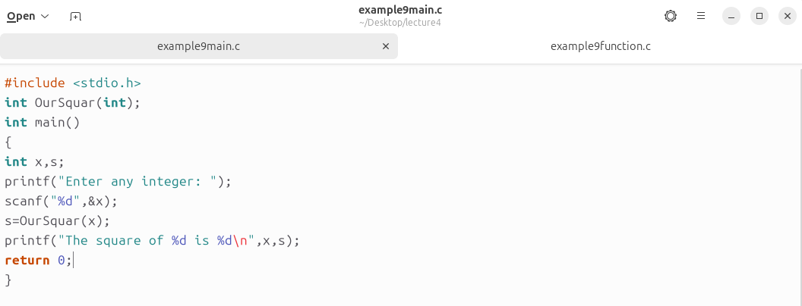
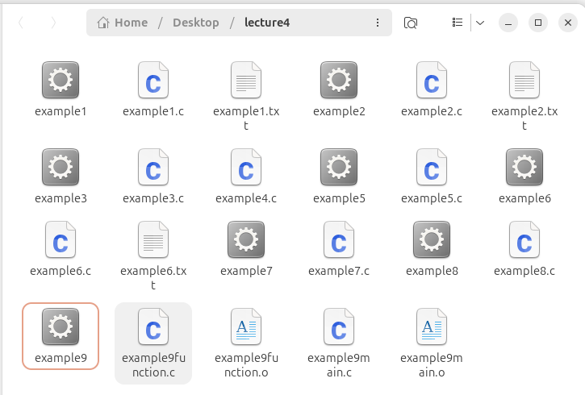
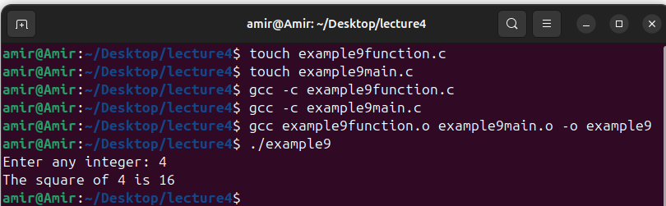
Example 9: Object Files and Linking
In this example, we have two separate C files: one that calculates the square of a number and another that asks the user for a number and prints its square. We will build object files from these C files and then combine them to create an executable program.
Link object files

Slide 43
Why Care About Object Files and Linking
Modularity: Allows us to manage and update individual parts of our program without affecting the whole.
Efficiency: Reduces the need to recompile the entire program when only parts of it change.
Flexibility: Lets us use code written in different languages and combine multiple files.
Hence mastering object files and linking is crucial for managing larger programs and optimizing development workflows.
Understanding these basics enhances our ability to write, manage, and deploy efficient programs.

Slide 44
Makefiles
When building a program from a single source code file, we typically run a single compile command.
For larger programs with multiple files, we may need to run several compile commands, some of which may involve multiple filenames and options.
This process can become tedious and error-prone.
To solve this problem, programmers use Makefiles.
A Makefile is a special file that organizes compile commands and intermediate files, allowing you to rebuild your program efficiently with minimal manual effort.

Slide 45
Makefiles
A Makefile is a text file that we place in our project's directory, usually alongside our source code files.
A Makefile consists of two main components:
Dependencies: These define the relationships between files. For example, if a source file changes, the corresponding object file must be recompiled.
Commands: These are the actual steps or commands needed to rebuild the files.
format of a dependency/command block is as follows:
file : dependency file: The file you want to create or update. Dependency: The files that the target depends on.
[TAB] command Command: The command to execute if the dependency has changed.
[TAB] command

Slide 46
Makefiles
A Makefile is a text file that we place in our project's directory, usually alongside our source code files.
A Makefile consists of two main components:
Dependencies: These define the relationships between files. For example, if a source file changes, the corresponding object file must be recompiled.
Commands: These are the actual steps or commands needed to rebuild the files.
format of a dependency/command block is as follows:
file : dependency file: The file you want to create or update. Dependency: The files that the target depends on.
[TAB] command Command: The command to execute if the dependency has changed.
[TAB] command

Slide 47
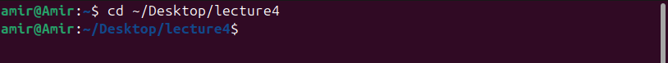
Steps to Create a Makefile
Steps to Create a Makefile in Linux:
Open a Terminal: Start by opening a terminal on your Linux system.
Navigate to Your Project Directory: Use the cd command to navigate to the directory where you want to create the Makefile. For example: cd /path/to/your/project
Create and Open the Makefile Using a Text Editor: You can use any text editor, such as nano, vim, or gedit. Here's how to do it with gedit, which is a graphical text editor.
Install gedit by: sudo snap install gedit (only run this commend for the first time)
Open text editor by: gedit Makefile &
Why &: Running in the Background and this allows us to continue using the terminal for other commands while gedit is still open.

Slide 48
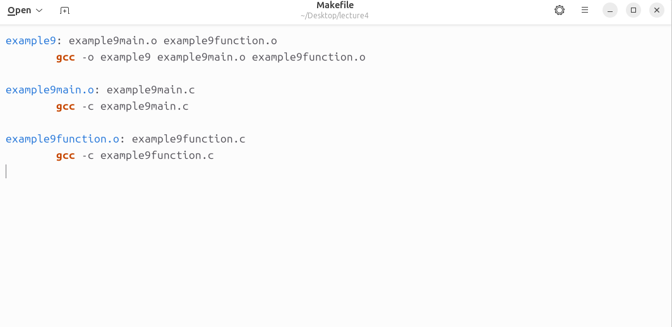
Steps to Create a Makefile
Steps to Create a Makefile in Linux:
Enter the Content of the Makefile: Once the text editor is open, you can type or paste the content of your Makefile. Here's an example:
Make sure each command line begins with a TAB character.

Slide 49
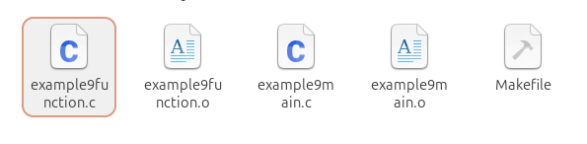
Steps to Create a Makefile
Steps to Create a Makefile in Linux:
Save and Close the File:
If you're using nano, press Ctrl + O to save the file, and then Ctrl + X to exit.
If you're using vim, press Esc, then type :wq and press Enter to save and quit.
If you're using gedit, just click the save icon or press Ctrl + S, then close the window.
Verifying the Makefile: After creating the Makefile, you can verify that it is working by running the make command in the terminal:

Slide 50
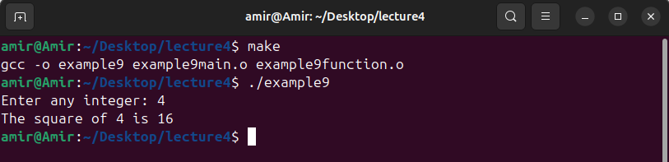
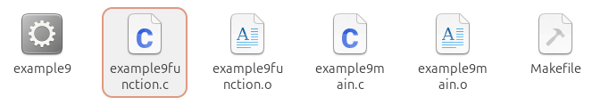
Steps to Create a Makefile
Steps to Create a Makefile in Linux:
Verifying the Makefile: After creating the Makefile, we can verify that it is working by running the make command in the terminal:
Execute the commends in the Makefile to build the project
Execute the compiled program

Slide 51
Thank you for listening

